Slide 1

Review of Basic Data Analytic Methods Using R
Author : FU
Date : Mar-2022

Slide 2
Objectives
After studying this chapter, the student should be able to:
Understand the basic features of R
Understand how to do data exploration and analysis with R?
Understand methods for data evaluation

Slide 3
Content
Introduction to R
Exploratory Data Analysis
Statistical Methods for Evaluation

Slide 4
1. Introduction to R (1)
R is a programming language and software framework for statistical analysis and graphics.
Available for use under the GNU General Public License, R software and installation instructions can be obtained via the Comprehensive R Archive and Network
Import Data file by read.csv() function
# import a CSV file of the total annual sales for each customer
sales <- read.csv("c:/data/yearly_sales.csv")
# examine the imported dataset
head(sales)

Slide 5
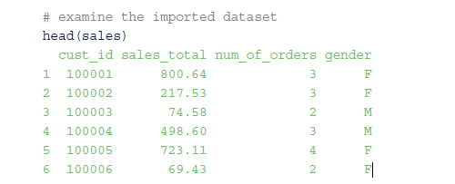
1. Introduction to R (2)
Head() function, by default, displays the first six records of sales

Slide 6
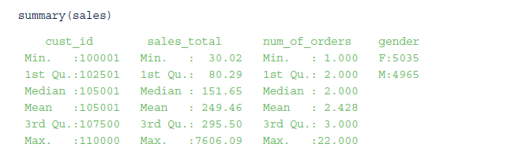
1. Introduction to R (3)
summary() function provides some descriptive statistics, such as the mean and median, for each data column

Slide 7
1. Introduction to R (4)
plot() function generates a scatterplot of the number of orders (sales$num_of_orders) against the annual sales (sales$sales_total).
# plot num_of_orders vs. sales
plot(sales$num_of_orders,sales$sales_total,
main="Number of Orders vs. Sales")

Slide 8
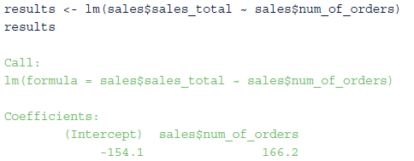
1. Introduction to R (5)
lm() function use for linear regression modeling process
intercept and slope values are –154.1 and 166.2, respectively, for the fitted linear equation
Notes:
resulting intercept and slope values : giá trị chặn và độ dốc kết quả

Slide 9
1. Introduction to R (6)
attributes() function use to show details on the contents of results.
summary() function is a generic function. A generic function is a group of functions sharing the same name but behaving differently depending on the number and the type of arguments.
plot() is another example of a generic function
hist() to generate a histogram (Figure 3-2) of the residuals stored in results

Slide 10
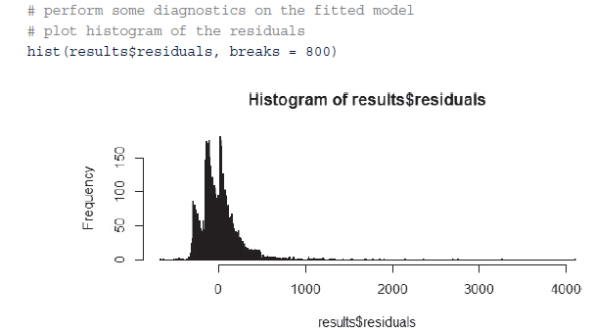
1. Introduction to R (7)
FIGURE 3-2 Evidence of large residuals

Slide 11
1.1R Graphical User Interfaces
R software uses a command-line interface (CLI) that is similar to the BASH shell in Linux or the interactive versions of scripting languages such as Python
RGui.exe provides a basic graphical user interface (GUI) of R in Window version
Popular GUIs: R commander, Rattle, and RStudio

Slide 12
1.1R Graphical User Interfaces - RStudio GUI (1)
Notes:
● Scripts: Serves as an area to write and save R code
● Workspace: Lists the datasets and variables in the R environment
● Plots: Displays the plots generated by the R code and provides a straightforward mechanism to
export the plots
● Console: Provides a history of the executed R code and the outputScripts: Serves as an area to write and save R code
● Workspace: Lists the datasets and variables in the R environment
● Plots: Displays the plots generated by the R code and provides a straightforward mechanism to
export the plots
● Console: Provides a history of the executed R code and the output

Slide 13
1.1R Graphical User Interfaces- RStudio GUI (2)
?lm or help(lm) at the console prompt can be used to obtain help information on R
edit() and fix() allow the user to update the contents of an R variable. Alternatively, such changes can be implemented with RStudio by selecting the appropriate variable from the workspace pane.
R allows one to save the workspace environment, including variables and loaded libraries, into an .Rdata file using the save.image() function. An existing .Rdata file can be loaded using the load.image() function

Slide 14
1.1R Graphical User Interfaces- RStudio GUI (3)
FIGURE 3-4 Accessing help in Rstudio

Slide 15
1.2 Data Import and Export (1)
read.csv() function use to import dataset from file
sales <- read.csv("c:/data/yearly_sales.csv")
Forward slash (/) as the separator character in the directory and file paths
setwd() function used to Import of multiple files with long path names
setwd("c:/data/")
sales <- read.csv("yearly_sales.csv")
read.table() and read.delim() are intended to import other common file types such as TXT
sales_table <- read.table("yearly_sales.csv", header=TRUE, sep=",")
sales_delim <- read.delim("yearly_sales.csv", sep=",")

Slide 16
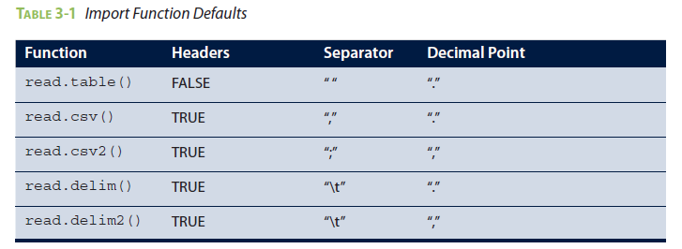
1.2 Data Import and Export (2)
Main difference between these import functions is the default values. E.g. read.delim() function expects the column separator to be a tab ("\t").

Slide 17
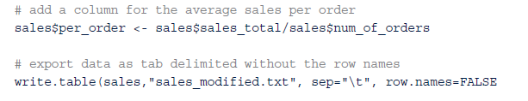
1.2 Data Import and Export (3)
write.table(), write.csv(), and write.csv2() enable exporting of R datasets to an external file.
For example, following R code adds an additional column to the sales dataset and exports the modified dataset to an external file.

Slide 18
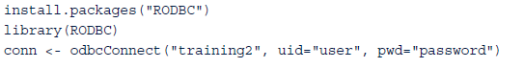
1.2 Data Import and Export (4)
DBI and RODBC are R packages used to read data from a database management system (DBMS). These packages provide database interfaces for communication between R and DBMSs such as MySQL, Oracle, SQL Server, PostgreSQL, and Pivotal Greenplum
install.packages() function used to install R packages
library() function used to loads the package into the R workspace
connector (conn) is initialized for connecting to a Pivotal Greenplum database training2 via open database connectivity (ODBC) with user=user
training2 database must be defined either in the /etc/ODBC.ini configuration file or using the Administrative Tools under the Windows Control Panel.

Slide 19
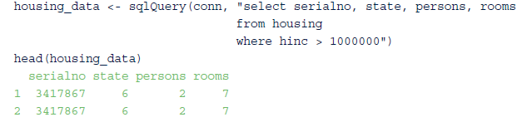
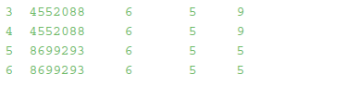
1.2 Data Import and Export (5)
connector needs to be present to submit a SQL query to an ODBC database by using the sqlQuery() function from the RODBC package (Ref: https://rdrr.io/cran/RODBC/man/)
following R code retrieves specific columns from the housing table in which household income (hinc) is greater than $1,000,000.
Use sqlFetch(conn, “housing_data”, max = 100)

Slide 20
1.2 Data Import and Export (6)
Using DBI package (Ref: https://dbi.r-dbi.org/reference/)
Install library install.packages("odbc")
Connect to SQL database
con <- DBI::dbConnect(odbc::odbc(),
Driver = “SQL Server ",
Server = "[your server's path]",
Database = "[your database's name]",
UID = "[your user name]",
PWD = [“Database password“],
Port = 1433)
Select data
query <- dbSendQuery(con, "SELECT speed, dist FROM cars")
dbFetch(query, n = 10)
dbClearResult(query)

Slide 21
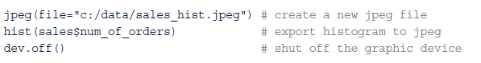
1.2 Data Import and Export (7)
jpeg() function used to creates a new JPEG file, adds a histogram plot to the file, and then closes the file.
jpeg() is useful when automating standard reports.
png(), bmp(), pdf(), and postscript(), are available in R to save plots in the desired format.

Slide 22
1.3 Attribute and Data Types (1)
In the earlier example, sales variable contained a record for each customer. Several characteristics, such as total annual sales, number of orders, and gender, were provided for each customer
These characteristics or attributes provide qualitative and quantitative measures for each item or subject of interest
Attributes can be categorized into four types: nominal, ordinal, interval, and ratio

Slide 23
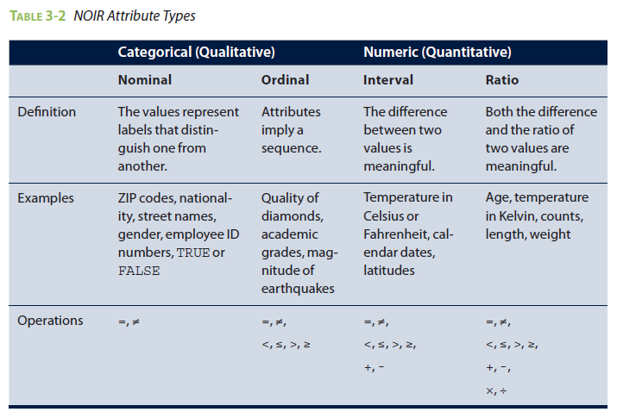
1.3 Attribute and Data Types (2)

Slide 24
1.3 Attribute and Data Types (3)
Data of one attribute type may be converted to another. For example,
quality of diamonds {Fair, Good, Very Good, Premium, Ideal} is considered ordinal but can be converted to nominal {Good, Excellent} with a defined mapping.
A ratio attribute like Age can be converted into an ordinal attribute such as {Infant, Adolescent, Adult, Senior}
Understanding attribute types in a dataset is to select the appropriate descriptive statistics and analytic methods (applied and properly interpreted)
Notes:
Adolescent: thanh niên

Slide 25
1.3.1 Numeric, Character, and Logical Data Types (1)
R supports numeric, character, and logical (Boolean) values.
Examples of such variables are given in the following R code
R provides several functions, e.g. class() and typeof(), to examine the characteristics of a given variable.
class() function represents the abstract class of an object.
typeof() function determines the way an object is stored in memory
i appears to be an integer, i is internally stored using double precision
i <- 1 # create a numeric variable
sport <- "football" # create a character variable
flag <- TRUE # create a logical variable

Slide 26
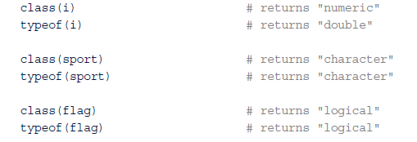
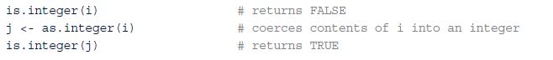
1.3.1 Numeric, Character, and Logical Data Types (2)
R functions can test the variables and coerce a variable into a specific type.
is.integer() function to test if i is an integer
as.integer() function to coerce i into a new integer variable, j . It can be applied for double, character, and logical types.

Slide 27
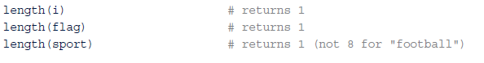
1.3.1 Numeric, Character, and Logical Data Types (3)
length() return the created variables each have a length of 1.
One might have expected the returned length of sport to have been 8 for each of the characters in the string "football". However, these three variables are actually one element, vectors.

Slide 28
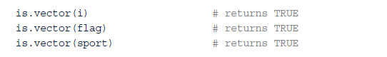
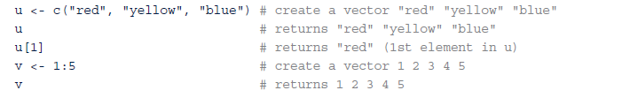
1.3.2 Vectors (1)
Vectors are a basic building block for data in R. Simple R variables are vectors.
A vector can only consist of values in the same class.
is.vector() function used to tests vectors
c() or colon operator, : used to create a vector
To build a vector from the sequence of integers from 1 to 5 as below example

Slide 29
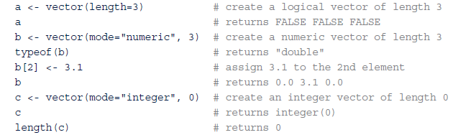
1.3.2 Vectors (2)
A vector of a specific length can be initialized and then populate the content of the vector later.
vector() function creates a logical vector by default. A vector of a different type can be specified by using the mode parameter.
Vector c, an integer vector of length 0, may be useful when the number of elements is not initially known and new elements will later be added to the end of the vector as the values become available.

Slide 30
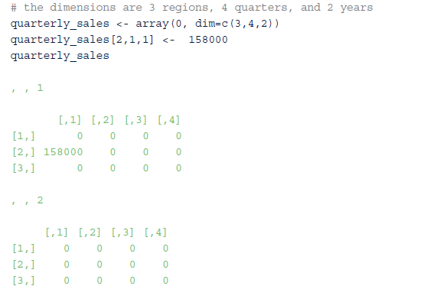
1.3.3 Arrays and Matrices (1)
array() function can be used to restructure a vector as an array
Below is a three-dimensional array to hold the quarterly sales for three regions over a two-year period and then assign the sales amount of $158,000 to the second region for the first quarter of the first year.

Slide 31
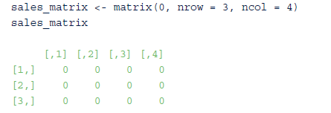
1.3.3 Arrays and Matrices (2)
matrix is a two-dimensional array
Below is a matrix to hold the quarterly sales for the three regions. Parameters nrow and ncol define the number of rows and columns, respectively, for the sales_matrix.

Slide 32
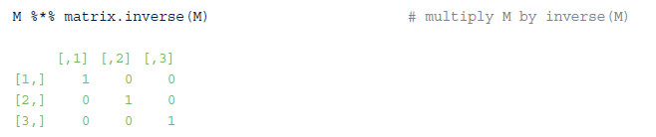
1.3.3 Arrays and Matrices (3)
Matrix operations - addition, subtraction, multiplication, and transpose function t() and the inverse matrix function matrix.inverse() included in the matrixcalc package.
Following R code builds a 3 × 3 matrix, M, and multiplies it by its inverse to obtain the identity matrix.

Slide 33
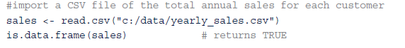
1.3.4 Data Frames (1)
Data frames provide a structure for storing and accessing several variables of possibly different data types.
is.data.frame() function indicates, a data frame was created by the read.csv() function

Slide 34
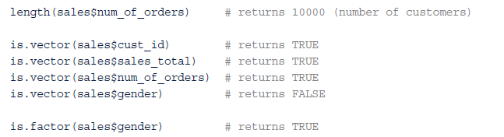
1.3.4 Data Frames (2)
$ notation used to assess variables stored in the data frame
Following R code illustrates that in this example, each variable is a vector with the exception of gender, which was, by a read.csv() default, imported as a factor
Factor denotes a categorical variable, typically with a few finite levels such as “F” and “M” in the case of gender.

Slide 35
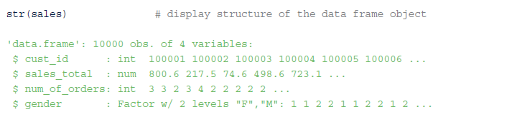
1.3.4 Data Frames (3)
Data frames are preferred input format for many of the modeling functions available in R
Following use of the str() function provides the structure of the sales data frame. This function identifies integer and numeric (double) data types, the factor variables and levels, as well as the first few values for each variable.

Slide 36
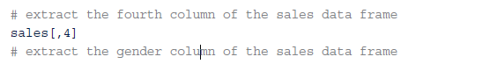
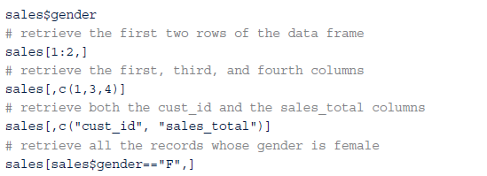
1.3.4 Data Frames (4)
In the simplest, data frames are lists of variables of the same length.
subsetting operators can be used to retrieve a subset of the data frame. They allow one to express complex operations in a succinct fashion and easily retrieve a subset of the dataset.

Slide 37
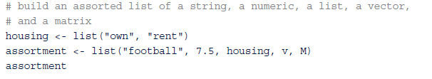
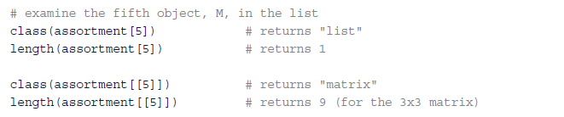
1.3.5 List
Contain any type of objects, including other lists.
Using the vector v and the matrix M created in earlier examples, the following R code creates assortment, a list of different object types.
Use double brackets, [ [] ] to display the contents of assortment
Use single set of brackets only accesses an item in the list, not its content

Slide 38
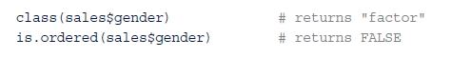
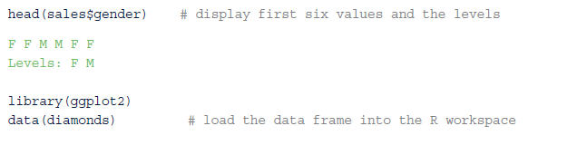
1.3.6 Factors (1)
gender variable in the data frame sales is an factor.
In this case, gender could assume one of two levels: F or M. Factors can be ordered or not ordered. In the case of gender, the levels are not ordered.
Included with ggplot2 package, the diamonds data frame contains three ordered factors.
Examining the cut factor, there are five levels in order of improving cut:
Fair, Good, Very Good, Premium, and Ideal.
sales$gender contains nominal data, and diamonds$cut contains ordinal data.

Slide 39
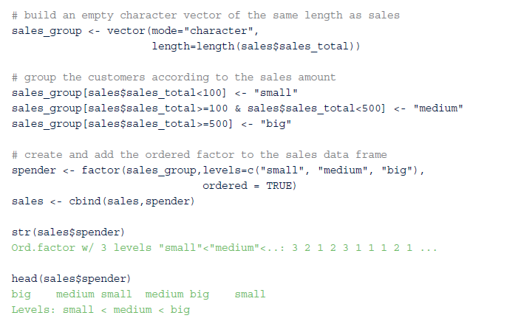
1.3.6 Factors (2)
Following code to categorize sales$sales_totals into three groups—small, medium, and big—according to the amount of the sales.
These groupings are the basis for the new ordinal factor, spender, with levels {small, medium, big}.
Notes:
The cbind() function is used to combine variables column-wise. The rbind() function is used
to combine datasets row-wise. The use of factors is important in several R statistical modeling functions,
such as analysis of variance, aov(), presented later in this chapter, and the use of contingency tables,
discussed next.

Slide 40
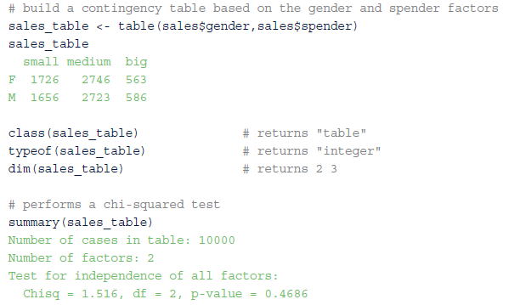
1.3.7 Contingency Tables
table refers to a class of objects used to store the observed counts across the factors for a given dataset.
a table is commonly referred to as a contingency table and is the basis for performing a statistical test on the independence of the factors used to build the table.
Following R code builds a contingency table based on the sales$gender and sales$spender factors.

Slide 41
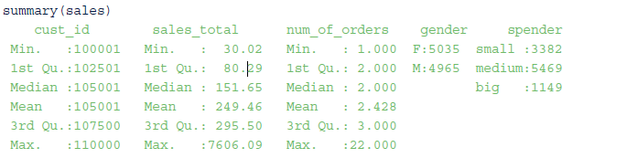
1.4 Descriptive Statistics (1)
summary() function provides several descriptive statistics, e.g. mean and median, about a variable such as the sales data frame.
results now include the counts for the three levels of the spender variable based on the earlier examples involving factors.

Slide 42
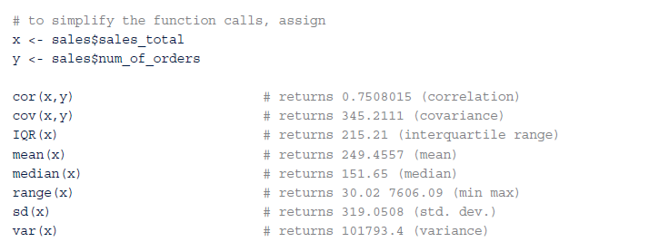
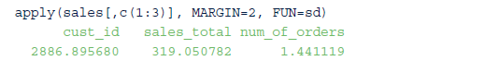
1.4 Descriptive Statistics (2)
Following code provides some common R functions that include descriptive statistics. In parentheses, the comments describe the functions.
Notes:
The IQR() function provides the difference between the third (phân vị thứ 3) and the first quartiles (Phân vị thứ nhất). The other functions
are fairly self-explanatory by their names. The reader is encouraged to review the available help files
for acceptable inputs and possible options.
The function apply() is useful when the same function is to be applied to several variables in a data
frame. For example, the following R code calculates the standard deviation for the first three variables in
sales. In the code, setting MARGIN=2 specifies that the sd() function is applied over the columns.
Other functions, such as lapply() and sapply(), apply a function to a list or vector. Readers can refer
to the R help files to learn how to use these functions.

Slide 43
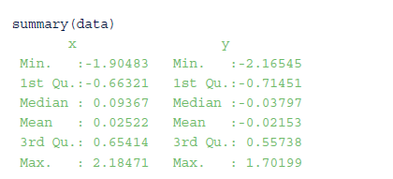
2 Exploratory Data Analysis (1)
summary() can help analysts get an idea of the magnitude and range of the data
Following code shows a summary view of a data frame data with two columns x and y. The output shows the range of x and y, but it’s not clear what the relationship may be between these two variables.

Slide 44
2 Exploratory Data Analysis (2)
Variables x and y of the data frame data can be visualized in a scatterplot
Figure 3-5 depicts the relationship between two variables
FIGURE 3-5 A scatterplot can easily show if x and y share a relation

Slide 45
2.1 Visualization Before Analysis (1)
Figure 3-6 illustrates the importance of visualizing data, consider Anscombe’s quartet. Anscombe’s quartet consists of four datasets.
It was constructed by statistician Francis Anscombe in 1973 to demonstrate the importance of graphs in statistical analyses.
FIGURE 3-6 Anscombe’s quartet

Slide 46
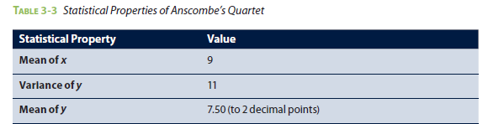
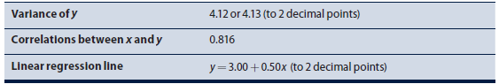
2.1 Visualization Before Analysis (2)
TABLE 3-3 Statistical Properties of Anscombe’s Quartet
FIGURE 3-7 Anscombe’s quartet visualized as scatterplots
Notes:
Based on the nearly identical statistical properties across each dataset, one might conclude that these
four datasets are quite similar. However, the scatterplots in Figure 3-7 tell a different story. Each dataset is
plotted as a scatterplot, and the fitted lines are the result of applying linear regression models. The estimated
regression line fits Dataset 1 reasonably well. Dataset 2 is definitely nonlinear. Dataset 3 exhibits a linear
trend, with one apparent outlier at x =13. For Dataset 4, the regression line fits the dataset quite well.
However, with only points at two x values, it is not possible to determine that the linearity assumption is
proper.

Slide 47
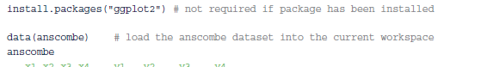
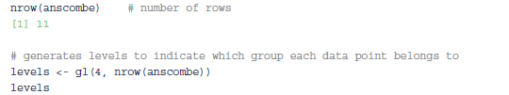
2.1 Visualization Before Analysis (3)
gl() function create variable levels, which generates factors of four levels (1, 2, 3, and 4), each repeating 11 times.
Variable mydata is created using the with(data, expression) function, which evaluates an expression in an environment constructed from data.
In this example, the data is the anscombe dataset, which includes eight attributes: x1, x2, x3, x4, y1, y2, y3, and y4.
expression part in the code creates a data frame from the nscombe dataset, and it only includes three attributes: x, y, and the group each data point belongs to (mygroup).

Slide 48
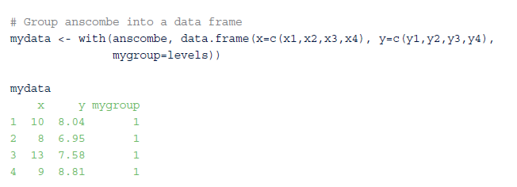
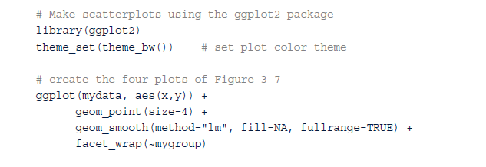
2.1 Visualization Before Analysis (4)

Slide 49
2.2 Dirty Data (1)
Consider a scenario in which a bank is conducting data analyses of its account holders to gauge customer retention. Figure 3-8 shows the age distribution of the account holders.
If age data is in a vector called age, the graph can be created with the following R script:
hist(age, breaks=100, main="Age Distribution of Account Holders", lab="Age", ylab="Frequency", col="gray")
figure shows that the median age of the account holders is around 40. A few accounts with account holder age less than 10 are unusual but plausible
FIGURE 3-8 Age distribution of bank account holders

Slide 50
2.2 Dirty Data (2)
Left side of the graph shows a huge spike of customers who are zero years old or have negative ages.
This is likely to be evidence of missing data. One possible explanation is that the null age values could have been replaced by 0 or negative values during the data input.
Such an occurrence may be caused by entering age in a text box that only allows numbers and does not accept empty values. Or it might be caused by transferring data among several systems that have different definitions for null values (such as NULL, NA, 0, –1, or –2).
Therefore, data cleansing needs to be performed over the accounts with abnormal age values. Analysts should take a closer look at the records to decide if the missing data should be eliminated or if an appropriate age value can be determined using other available information for each of the accounts.
Notes:
Spike: mũi nhọn

Slide 51
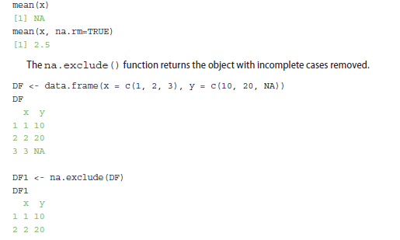
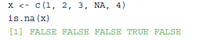
2.2 Dirty Data (3)
is.na() function provides tests for missing values.
Following example creates a vector x where the fourth value is not available (NA). The is.na() function returns TRUE at each NA value and FALSE otherwise.
mean() applied to data containing missing values can yield an NA result. To prevent this, set the na.rm parameter to TRUE to remove the missing value during the function’s execution.

Slide 52
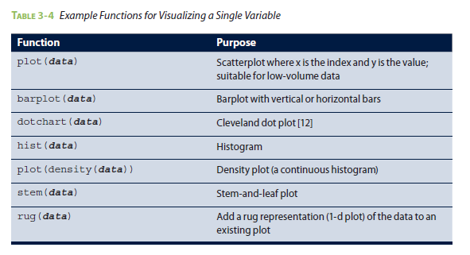
2.3 Visualizing a Single Variable (1)
R has many functions available to examine a single variable.

Slide 53
2.3 Visualizing a Single Variable (2)
dotchart(x, label=...) used to create a dotchart, where x is a numeric vector and label is a vector of categorical labels for x.
barplot(height) function used to create A barplot , where height represents a vector or matrix.
Figure 3-10 shows (a) a dotchart and (b) a barplot based on the mtcars dataset, which includes the fuel consumption and 10 aspects of automobile design and performance of 32 automobiles

Slide 54
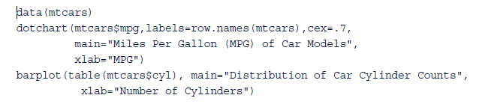
2.3 Visualizing a Single Variable (3)
dotchart can be created with the function dotchart(x, label=...),
x is a numeric vector and
label is a vector of categorical labels for x.

Slide 55
2.3 Visualizing a Single Variable (4)
Figure 3-11(a) includes a histogram of household income.
Histogram shows a clear concentration of low household incomes on the left and the long tail of the higher incomes on the right.

Slide 56
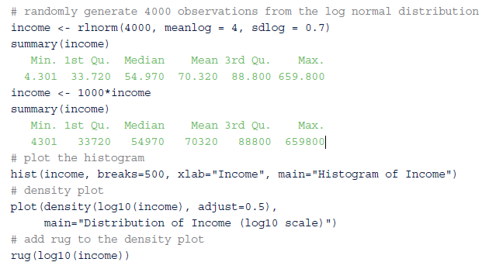
2.3 Visualizing a Single Variable (5)

Slide 57
2.3 Visualizing a Single Variable (6)
Consider a density plot of diamond prices (in USD).
Figure 3-12(a) contains two density plots for premium and ideal cuts of diamonds.
Figure 3-12(b) shows detail of the diamond prices than Figure 3-12(a) by taking the logarithm.
FIGURE 3-12 Density plots of (a) diamond prices and (b) the logarithm of diamond prices

Slide 58
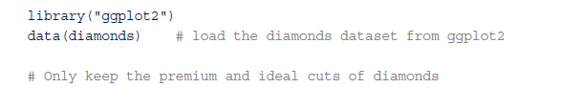
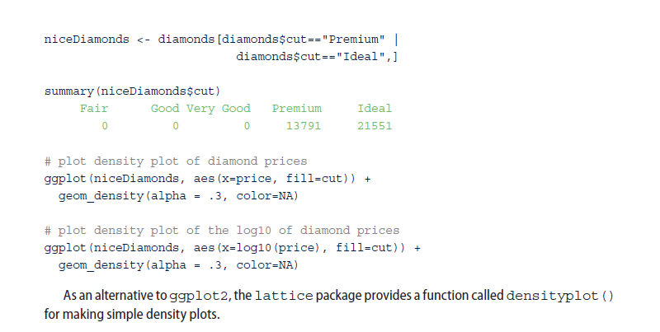
2.3 Visualizing a Single Variable (7)
R script to generate the plots in Figure.
The diamonds dataset comes with the ggplot2 package.

Slide 59
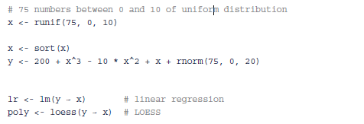
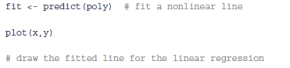

2.4 Examining Multiple Variables
R code to produce Figure 3-13
FIGURE 3-13 Examining two variables with regression

Slide 60
2.4 Examining Multiple Variables - Dotchart and Barplot
Dotchart and barplot from the previous section can visualize multiple variables. Both of them use color as an additional dimension for visualizing the data.
For the same mtcars dataset, Figure 3-14 shows a dotchart that groups vehicle cylinders at the y-axis and uses colors to distinguish different cylinders.
The vehicles are sorted according to their MPG values.
FIGURE 3-14 Dotplot to visualize multiple variables

Slide 61

2.4 Examining Multiple Variables - Dotchart and Barplot

Slide 62

2.4 Examining Multiple Variables- Dotchart and Barplot
barplot in Figure 3-15 visualizes the distribution of car cylinder counts and number of gears.
The x-axis represents the number of cylinders, and the color represents the number of gears
FIGURE 3-15 Barplot to visualize multiple variables

Slide 63

2.4 Examining Multiple Variables - Box-and-Whisker Plot
Graph shows how household income varies by region.
Highest median incomes are in region 0 and region 9. Region 0 is slightly higher, but the boxes for the two regions overlap enough that the difference between the two regions probably is not significant.
Lowest household incomes tend to be in region 7, which includes states such as Louisiana, Arkansas, and Oklahoma
FIGURE 3-16 A box-and-whisker plot of mean household income and geographical region

Slide 64


2.4 Examining Multiple Variables - Hexbinplot for Large Datasets
hexbinplot of Figure 3-17(b) is plotted by using zcta data frame.
Running the code requires the use of the hexbin package installed by running install.packages("hexbin")
FIGURE 3-17 (a) Scatterplot and (b) Hexbinplot of household income against years of education

Slide 65

2.4 Examining Multiple Variables - Scatterplot Matrix
vector colors defines the color scheme for the plot
colors <- c("gray50", "white", "black") to make the scatterplots grayscale.
FIGURE 3-18 Scatterplot matrix of Fisher’s [13] iris dataset

Slide 66
2.4 Examining Multiple Variables - Analyzing a Variable over Time
Visualizing a variable over time is the same as visualizing any pair of variables, but in this case the goal is to identify time-specific patterns. Figure 3-19 plots the monthly total numbers of international airline passengers (in thousands) from January 1940 to December 1960. Enter plot(AirPassengers) in the R console to obtain a similar graph. The plot shows that, for each year, a large peak occurs mid-year around July and August, and a small peak happens around the end of the year, possibly due to the holidays. Such a phenomenon is referred to as a seasonality effect.
plot(AirPassengers)
FIGURE 3-19 Airline passenger counts from 1949 to 1960

Slide 67
2.5 Data Exploration Versus Presentation
Figure 3-20 shows the density plot on the distribution of account values from a bank.
FIGURE 3-20 Density plots are better to show to data scientists

Slide 68


2.5 Data Exploration Versus Presentation

Slide 69
3.1 Hypothesis Testing (1)
Hypothesis testing is to form an assertion and test it with data
null hypothesis (H₀) refer to when performing hypothesis tests based on the common assumption is that there is no difference between two samples. This assumption is used as the default position for building the test or conducting a scientific experiment
alternative hypothesis (H_{A}) is that there is a difference between two samples
FIGURE 3-22 Distributions of two samples of data

Slide 70
3.1 Hypothesis Testing (2)
For example, if the task is to identify the effect of drug A compared to drug B on patients, the null hypothesis and alternative hypothesis would be this.
H₀: Drug A and drug B have the same effect on patients
H_{A}: Drug A has a greater effect than drug B on patients.
If the task is to identify whether advertising Campaign C is effective on reducing customer churn, the null hypothesis and alternative hypothesis would be as follows
H₀ : Campaign C does not reduce customer churn better than the current campaign method.
H_{A} : Campaign C does reduce customer churn better than the current campaign.

Slide 71

3.1 Hypothesis Testing (3)
It is important to state the null hypothesis and alternative hypothesis, because misstating them is likely to undermine the subsequent steps of the hypothesis testing process.
A hypothesis test leads to either rejecting the null hypothesis in favor of the alternative or not rejecting the null hypothesis.
Notes:
Alternative hypotheses: giả thiết thay thế/ giải thiết nghịch
Null hypotheses: giả thiết vô hiệu/Giả thiết rỗng

Slide 72
3.2 Difference of Means
H₀: μ₁ = μ₂
H_{A}: μ₁ ≠μ₂
The μ1 and μ2 denote the population means of pop1 and pop2, respectively.
FIGURE 3-23 Overlap of the two distributions is large if X1 2 ≈ X2

Slide 73

3.2.1 Student’s t-test (1)
Student’s t-test assumes that distributions of the two populations have equal but unknown variances. Suppose n1 and n2 samples are randomly and independently selected from two populations, pop1 and pop2.
If each population is normally distributed with same mean (μ1=μ2) and with the same variance, then T (the t-statistic), given in Equation 3-1, follows a t-distribution with n1 + n2 −2 degrees of freedom (df).
(3-1)
Notes:
- degrees of freedom : bậc tự do
- S² - Sample variance ; Phương sai (độ lệch)

Slide 74
3.2.1 Student’s t-test (2)
Shape of t-distribution is similar to normal distribution
Degrees of freedom approaches 30 or more, t-distribution is nearly identical to normal distribution
Numerator of T is difference of sample means, if the observed value of T is far enough from zero such that the probability of observing such a value of T is unlikely, one would reject the null hypothesis that population means are equal.
a small probability, say α=0.05, T * is determined such that P( |T| ≥T * )=0.05. After the samples are collected and the observed value of T is calculated according to Equation 3-1, the null hypothesis (μ1 = μ2) is rejected if |T| ≥T *.
Notes:
Numerator : tử số

Slide 75

3.2.1 Student’s t-test (3)
In hypothesis testing, small probability, α, is known as the significance level of the test
significance level of test is the probability of rejecting the null hypothesis, when the null hypothesis is actually TRUE. In other words, for α=0.05
if means from the two populations are truly equal, then in repeated random sampling, the observed magnitude of T would only exceed T * 5% of the time.
Following R code example, 10 observations are randomly selected from two normally distributed populations and assigned to variables x and y.
Two populations have a mean of 100 and 105, respectively, and a standard deviation equal to 5. Student’s t-test is then conducted to determine if the obtained random samples support the rejection of the null hypothesis.

Slide 76


3.2.2 Welch’s t-test (1)
Welch’s t-test can be used based on T expressed in Equation 3-2
where X_{i} , S_{i}², and n_{i} correspond to the i-th sample mean, sample variance, and sample size
Welch’s t-test uses sample variance (Si²) for each population instead of the pooled sample variance.
Following R code performs the Welch’s t-test on the same set of data analyzed in the earlier Student’s t-test example.
Notes:
S² _{- Sample} variance (Phương sai)

Slide 77

3.2.2 Welch’s t-test (2)
The degrees of freedom for Welch’s t-test is defined in Equation 3-3.

Slide 78
3.2.2 Welch’s t-test (3)
A confidence interval is an interval estimate of a population parameter or characteristic based on sample data
FIGURE 3-25 A 95% confidence interval straddling the unknown population mean μ
Notes:
Confidence interval : khoảng tin cậy

Slide 79
3.2.2 Welch’s t-test (4)
Confidence intervals discussed again in Section 3.3.6 on ANOVA.
A key assumption in both the Student’s and Welch’s t-test is that the relevant population attribute is normally distributed.
For non-normally distributed data, it is sometimes possible to transform the collected data to approximate a normal distribution.
For example, taking the logarithm of a dataset can often transform skewed data to a dataset that is at least symmetric around its mean. However, if such transformations are ineffective, there are tests like the Wilcoxon rank-sum test that can be applied to see if two population distributions are different.

Slide 80
3.3 Wilcoxon Rank-Sum Test (1)
Wilcoxon rank-sum test is a nonparametric hypothesis test that checks whether two populations are identically distributed
Let the two populations again be pop1 and pop2, with independently random samples of size n1 and n2 respectively. The total number of observations is then N =n1 + n2
Wilcoxon rank-sum test determines the significance of the observed rank-sums.
Following R code performs the test on the same dataset used for the previous t-test.
wilcox.test(x, y, conf.int = TRUE)

Slide 81
3.3 Wilcoxon Rank-Sum Test (2)
wilcox.test() function ranks observations, determines the respective rank-sums corresponding to each population’s sample, and then determines the probability of such rank-sums of such magnitude being observed assuming that the population distributions are identical.
In this example, the probability is given by the p-value of 0.04903.
Thus, the null hypothesis would be rejected at a 0.05 significance level. The reader is cautioned against interpreting that one hypothesis test is clearly better than another test based solely on the examples given in this section.

Slide 82

3.4 Type I and Type II Errors (1)

Slide 83
3.4 Type I and Type II Errors (2)
significance level mentioned in the Student’s t-test discussion is equivalent to the type I error.
For a significance level such as α=0.05, if null hypothesis (μ1= μ2) is TRUE, there is a 5% chance that the observed T value based on the sample data will be large enough to reject the null hypothesis.
By selecting n appropriate significance level, probability of committing a type I error can be defined before any data is collected or analyzed.
probability of committing a Type II error is somewhat more difficult to determine. If two population means are truly not equal, probability of committing a type II error will depend on how far apart the means truly are. To reduce the probability of a type II error to a reasonable level, it is often necessary to increase the sample size

Slide 84
3.5 Power and Sample Size
power of a test is the probability of correctly rejecting the null hypothesis denoted by 1−β, where β is probability of a type II error.
In general, the magnitude of the difference is known as the effect size. As the sample size becomes larger, it is easier to detect a given effect size, δ, as illustrated in Figure 3-26.
FIGURE 3-26 A larger sample size better identifies a fixed effect size

Slide 85
3.6 ANOVA (1)
Hypothesis tests presented are good for analyzing means between two populations. What if there are more than two populations? Consider an example of testing the impact of nutrition and exercise on 60 candidates between age 18 and 50. Candidates are randomly split into six groups, each assigned with a different weight loss strategy, and the goal is to determine which strategy is the most effective.
Group 1 only eats junk food.
Group 2 only eats healthy food.
Group 3 eats junk food and does cardio exercise every other day.
Group 4 eats healthy food and does cardio exercise every other day.
Group 5 eats junk food and does both cardio and strength training every other day.
Group 6 eats healthy food and does both cardio and strength training every other day.
Notes:
Analysis of Variance: Phân tích phương sai

Slide 86
3.6 ANOVA (2)
Multiple t-tests could be applied to each pair of weight loss strategies. In this example, the weight loss of Group 1 is compared with the weight loss of Group 2, 3, 4, 5, or 6. Similarly, the weight loss of Group 2 is compared with that of the next 4 groups. Therefore, a total of 15 t-tests would be performed.
However, multiple t-tests may not perform well on several populations for two reasons.
First, number of t-tests increases as number of groups increases, analysis using the multiple t-tests becomes cognitively more difficult.
Second, by doing a greater number of analyses, probability of committing at least one type I error somewhere in the analysis greatly increases.
ANOVA (Analysis of Variance) designed to address these issues. ANOVA is a generalization of the hypothesis testing of difference of two population means.
ANOVA tests if any of the population means differ from the other population means.
The null hypothesis is that all the population means are equal. H0: μ1= μ2 = =…=μn
Alternative hypothesis is that at least one pair of the population means is not equal. HA: μi ≠ μj for at least one pair of i, j

Slide 87

3.6 ANOVA (3)
In Section 3.3.2, “Difference of Means,” each population is assumed to be normally distributed with the same variance.
The first thing to calculate for the ANOVA is the test statistic. The goal is to test whether the clusters formed by each population are more tightly grouped than the spread across all the populations
k: total number of populations
N: total number of samples is randomly split into k groups
n_{i} number of samples in the i-th group
X_{i} mean of the group, i∈[1,k]
X₀ mean of all the samples
S²B (between-groups mean sum of squares) an estimate of the between-groups variance measures how the population means vary with respect to the grand mean, or the mean spread across all the populations

Slide 88


3.6 ANOVA (4)
S²_{W}:within-group mean sum of squares is an estimate of the within-group variance
If S_{B}² is much larger than S_{W}² , then some of the population means are different from each other.
F-test statistic is defined as the ratio of the between-groups mean sum of squares and the withingroup
mean sum of squares

Slide 89

3.6 ANOVA (5)

Slide 90

3.6 ANOVA (6)

Slide 91

3.6 ANOVA (7)

Slide 92
Summary
R is a popular package and programming language for data exploration, analytics, and visualization
How to use R to perform exploratory data analysis, including the discovery of dirty data, visualization of one or more variables, and customization of visualization for different audiences
Introduces some basic statistical methods
Hypothesis testing. The Student’s t-test and Welch’s t-test are included as two example hypothesis tests designed for testing the difference of means.
Other statistical methods and tools: confidence intervals, Wilcoxon rank-sum test, type I and II errors, effect size, and ANOVA

